Slide 1






BOA NOITE
START!

Slide 2
ANSWER
ESCOLHA O MULTIPLAYER
Andreza
Otavio
Daniel
Emilly

Slide 3

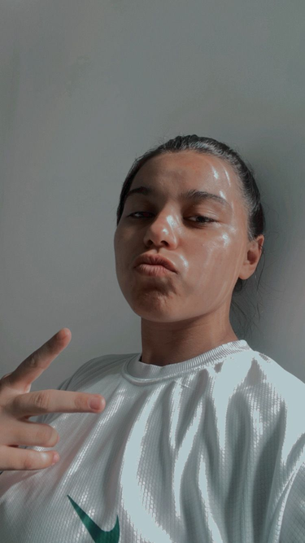

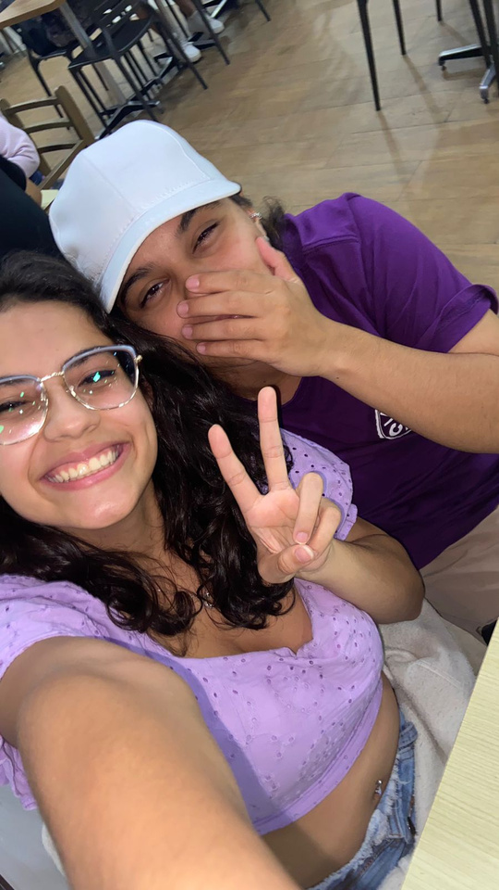
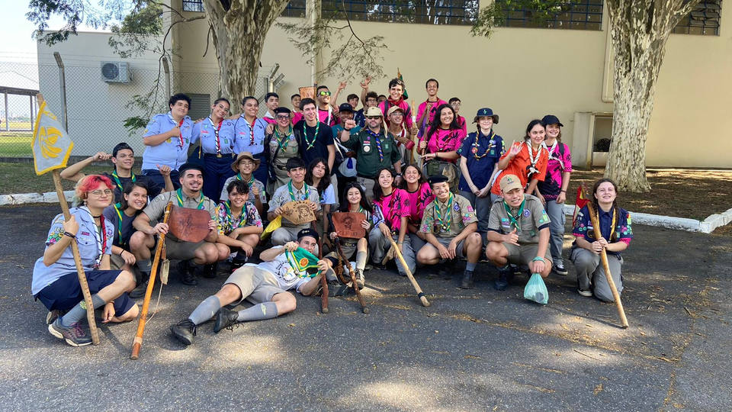





NICKNAME:
ANDREZA
VIDA
HOBBY
SONHO

Slide 4
ANSWER
ESCOLHA O MULTIPLAYER
Andreza
Otavio
Daniel
Emilly

Slide 5
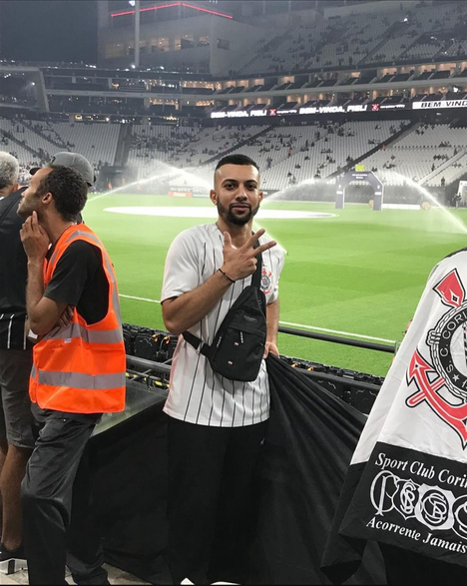
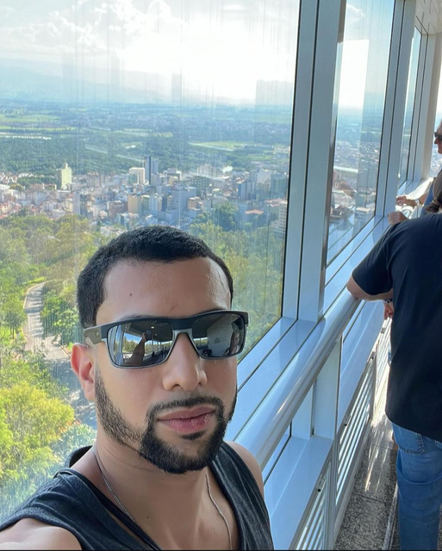
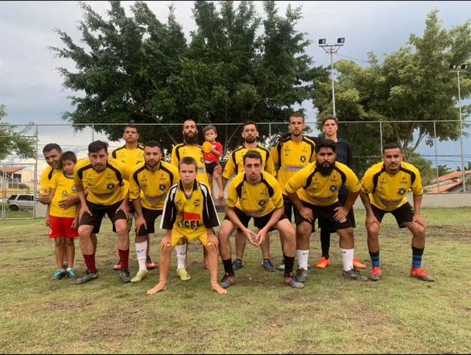
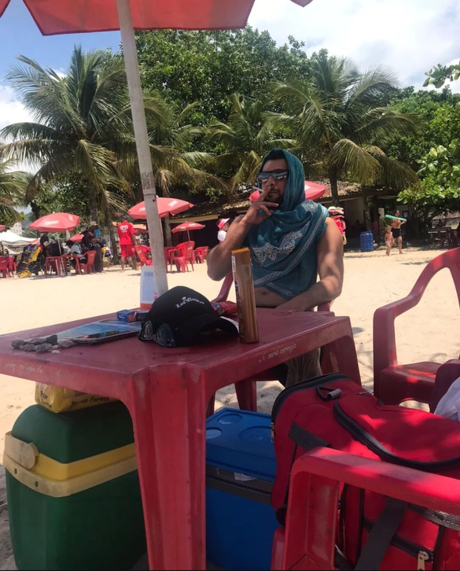



NICKNAME:
OTAVIO
VIDA
HOBBY
SONHO

Slide 6
ANSWER
ESCOLHA O MULTIPLAYER
Andreza
Otavio
Daniel
Emilly

Slide 7
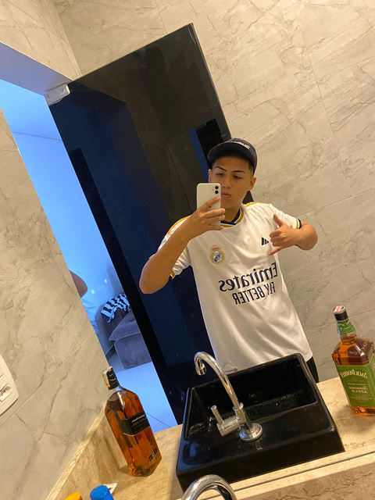
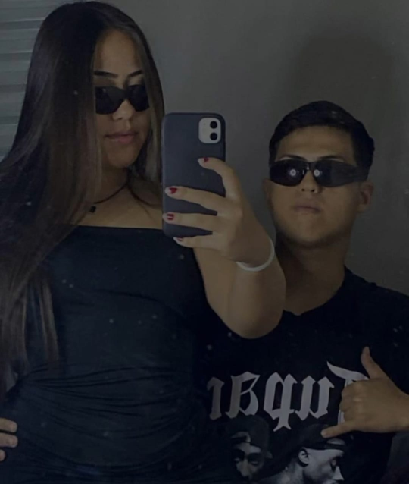
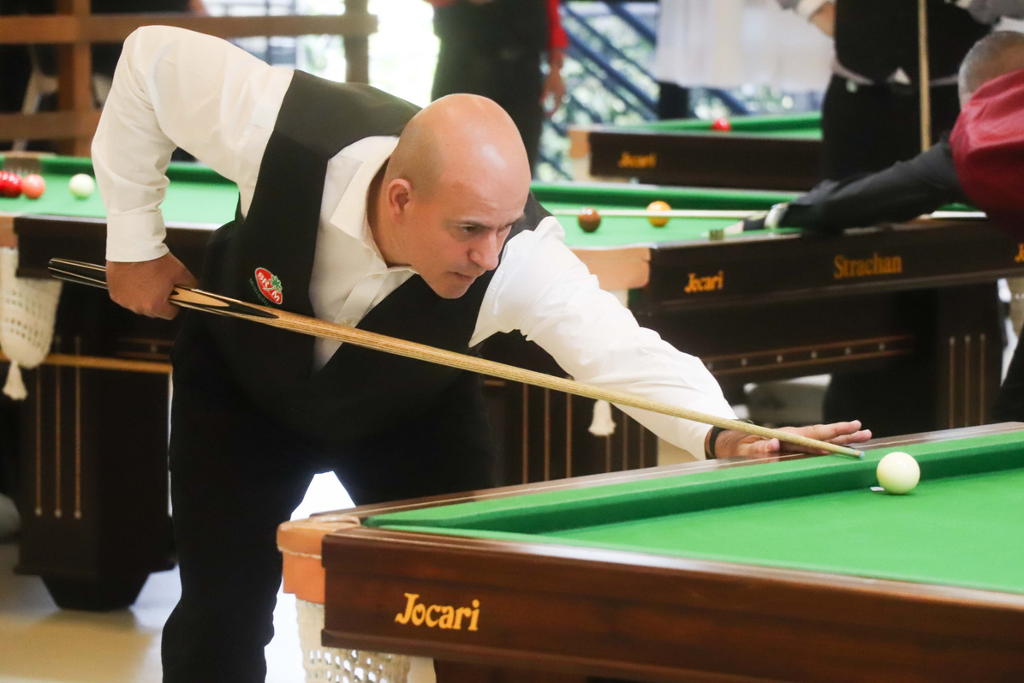
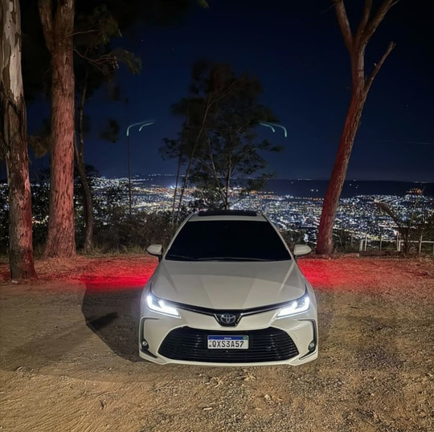

NICKNAME:
DANIEL
VIDA
HOBBY
SONHO

Slide 8
ANSWER
ESCOLHA O MULTIPLAYER
Andreza
Otavio
Daniel
Emilly

Slide 9
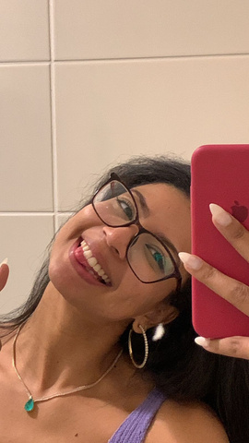
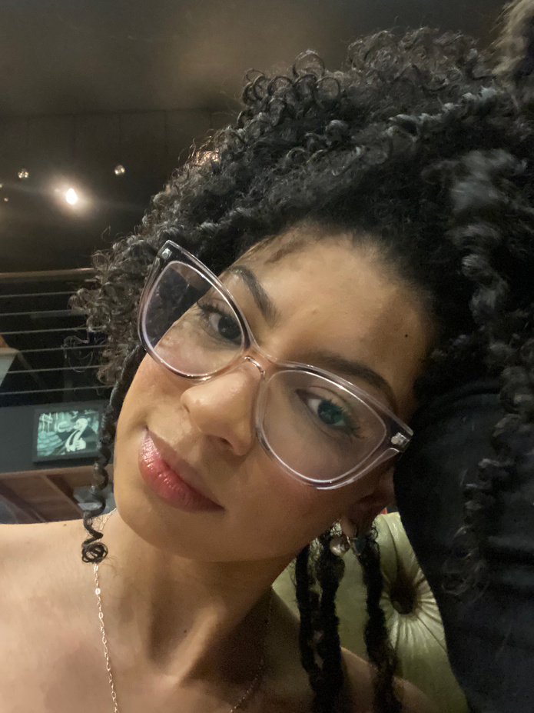

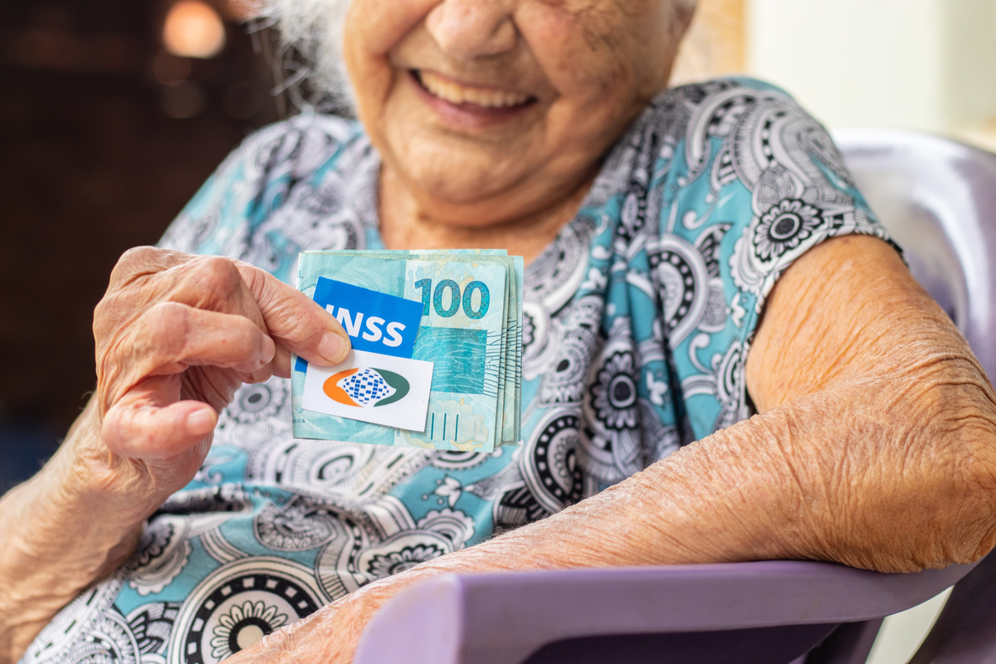
NICKNAME:
EMILLY
VIDA
HOBBY
SONHO

Slide 10
THANK YOU
END

